Slide 1


TUTORIAL Applying rigorous machine learning methods in business strategy
Mash Zahid
09 January 2019

Slide 2
SPEAKER PROFILE

Slide 3
Mash Zahid
Corporate Strategy VP & Principal Data Scientist
Highlights | Mash served as senior strategy manager at The Home Depot, where his data-driven approach for improving retail operations and People strategy was detailed in Harvard Business Review's April 2006 cover story. He also served on the M&A teams for HD Supply and an international conglomerate. In recent years, he served as the Associate Partner & head of the ML Practice supporting Microsoft and its major Azure clients. On his own hands-on engagements, he developed automated Inventory Optimization of engine assembly at Subaru Automotive with advanced ML, maintenance recommendations for connected surgical equipment at Stryker, IoT predictive maintenance for all paint mixers at home improvement retail stores, and proprietary trading and valuation algorithms for hedge fund Looking Glass Investments. His core Data Science and Machine Learning experience includes projects at biotech Amgen Digital Health for patient medication adherence & Cardiovascular Clinical Decision Support.
Expertise | Digital Health, Precision Medicine, Patients Disease Identification & Medication Adherence Hedge Fund Trading & Econometrics Machine Learning Models Corporate Strategy & Enterprise Planning at Fortune 15 Companies AI solutions designed & operationalized at leading carmaker & biotech companies, among others Led the Machine Learning Practice for a leading Microsoft Consulting Services Gold Partner focused on Azure Cloud Platform Domain expertise in Biotech, Financial Services, Industrial and Retail
Education | The University of Chicago Booth School of Business - MBA, Analytic Finance & Accounting with Economics PhD work College of Wooster - BA, Mathematics and Political Science
Blogs | How to Build a Scalable Data Science Strategy https://businesstalentgroup.com/blog/how-to-build-a-scalable-data-science-strategy/

Slide 4
TUTORIAL on Applying rigorous machine learning methods in business strategy
This tutorial will provide a hands-on overview of a business strategy project that applies machine learning with a focus on the Python code and common packages, followed by business interpretation of model results and findings.
The presented Python code and process can serve as a useful starting template for typical Data Science projects.
Please message me on Twitter @MashZahid if you would like to receive the Jupyter notebook code & supporting materials afterwards to use freely as a template for your own projects.
As Data Science matures across all companies, there is still a growing opportunity to incorporate advanced machine learning methods inside and by the business functions themselves. Despite massive investments hiring the best data scientists and even more on consulting services, many large companies are not getting the value returns that they expected.
For data-driven projects to create value, the business must ask smart questions, wrangle the relevant data, and uncover fresh insights – this is what classically trained data scientists do well. Understanding what the insights mean for the business and communicating those insights effectively comes from experience, therefore, it is crucial for existing team members across all functions within the organization to explore machine learning methods bravely.
As data-driven culture becomes the default in successful organizations, both executive and business staff will learn to conduct ML experiments by leveraging fundamental statistical knowledge with the usual ML and new AutoML tools.

Slide 5
“It’s only a few lines of code, but it’s a few lines that only a data scientist can write.”

Slide 6
BUSINESS STRATEGY CASE using human resources data
The strategic objective is identifying a predictive model for attrition (employee staff leaving the company, presumably voluntarily), which is a direct cost impact to the business and indirect cost to continuing operations.
Exploratory analysis
Feature engineering (manual – please remind me to kick off RapidMiner)
Building classification models
Training & testing the classification models
Improving the models with dimensionality reduction
Operationalizing this (manual) model
Compare performance with H2O AutoML run
Compare performance with RapidMiner Auto Model
This data science solution involves finding a classification model using historical People data to predict the probability of current employees leaving.
The value of strategic decisions are enhanced by having better predictions. A good manager asks what is a better (and perhaps, more accurate) prediction worth to business operations.
And, with better predictions come more opportunities for growth.

Slide 7
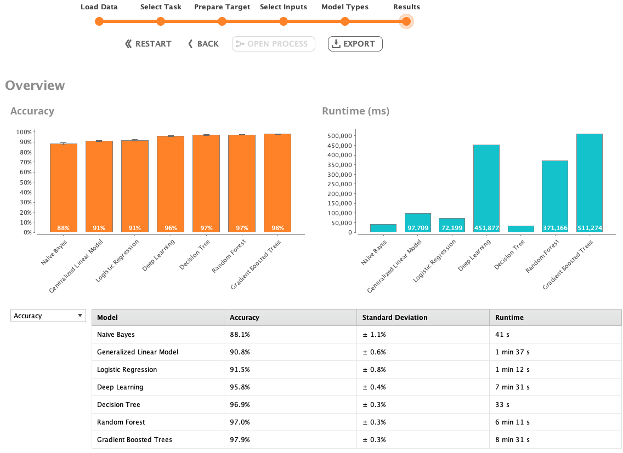

Slide 8
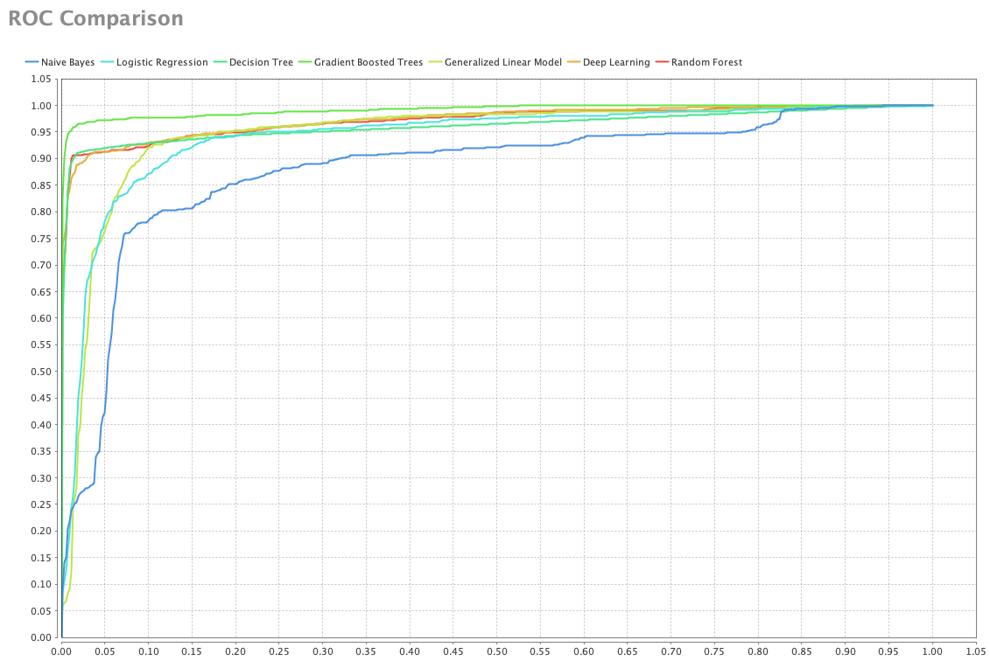

Slide 9
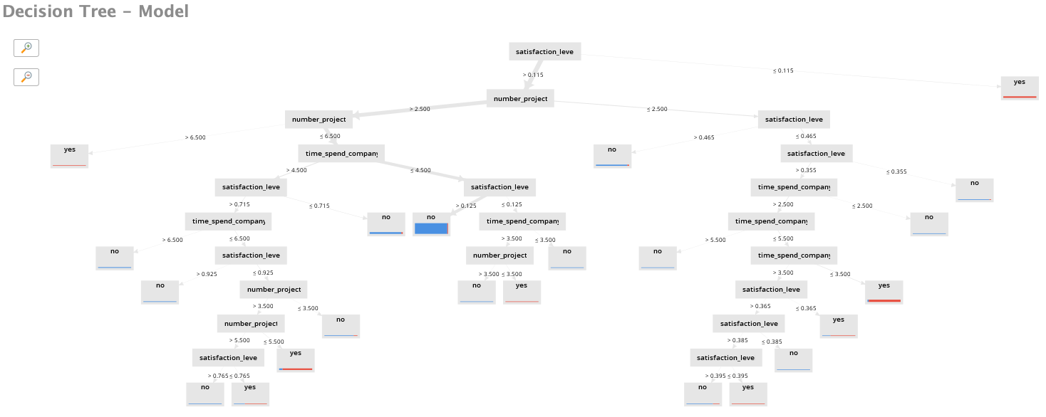

Slide 10
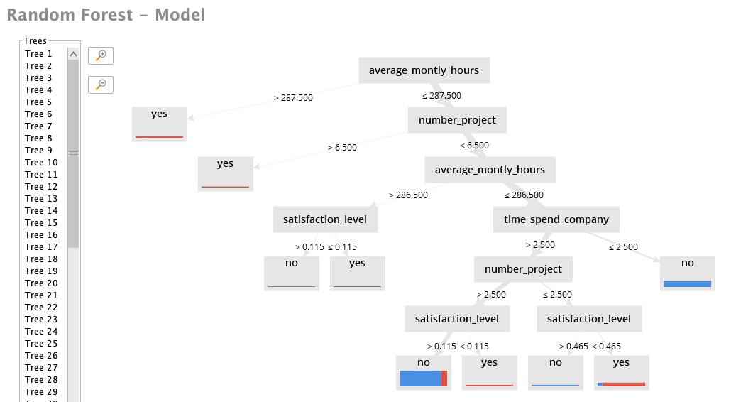

Slide 11
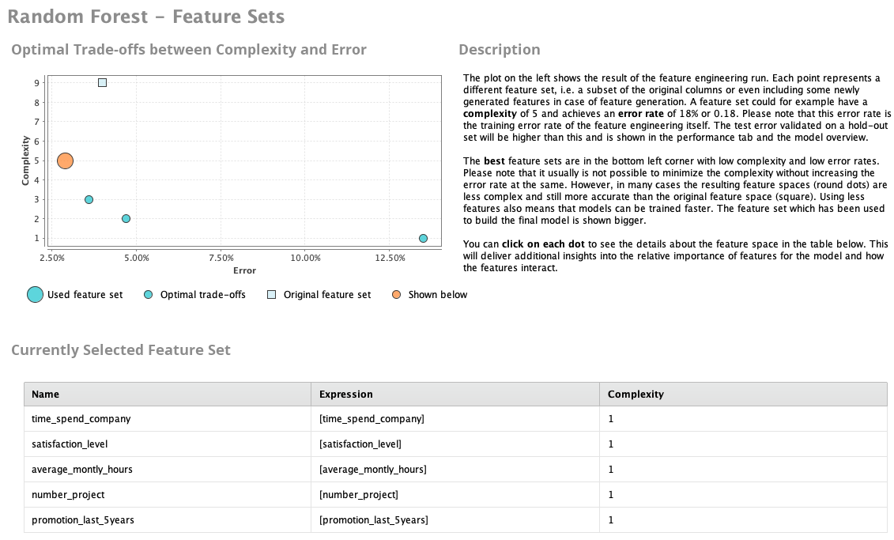

Slide 12
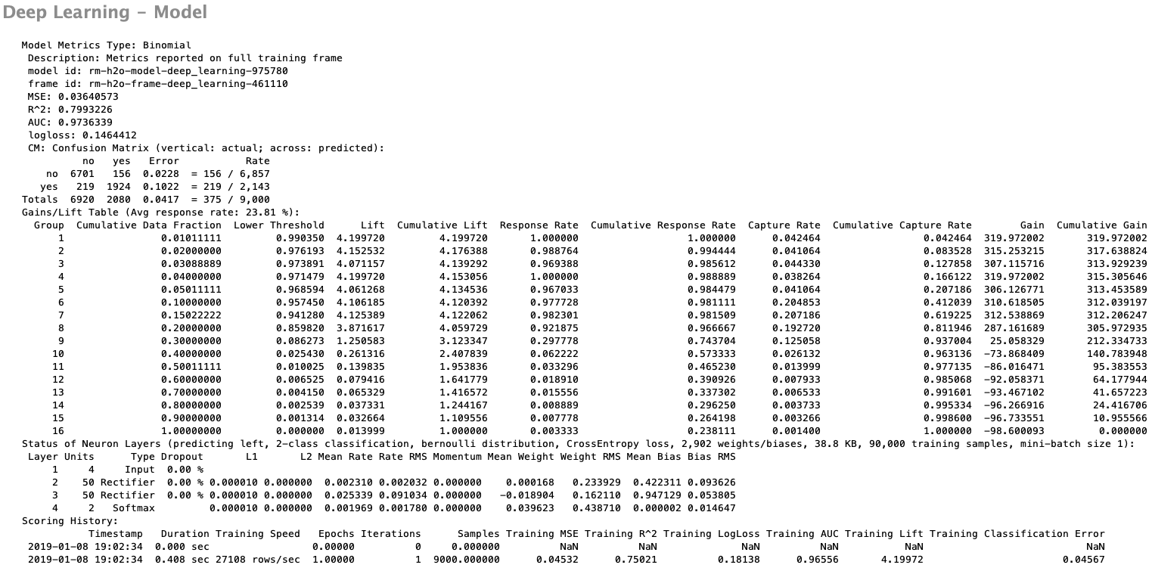

Slide 13
